Slide 1
EFFECTIVENESS OF A DASHBOARD

Slide 2
Agenda Style
01
Overview
02
Dataset
03
EDA Process
04
Data Set after EDA
05
Power BI
06
Conclusion
07
References

Slide 3
Overview

Slide 4
Living with fear stops us taking risks, and if you don't go
out on the branch, you're never going to get the best fruit.
- Sarah Parish
The roots of education are bitter, but the fruit is sweet.
- Aristotle

Slide 5
Overview
Data set analysis – Specific to Ontario
EDA Process carried out on the dataset
Final data
Research questions from Power BI
Which product average price is better?
Is there a relation between the bearing area of land used and the marketed production ?
Has there been an increase or decrease in the productions of the crops over the years?
Is there a pattern observed for the farm value ?
Is there a specific province that is doing better than other ?

Slide 6
Dataset

Slide 7
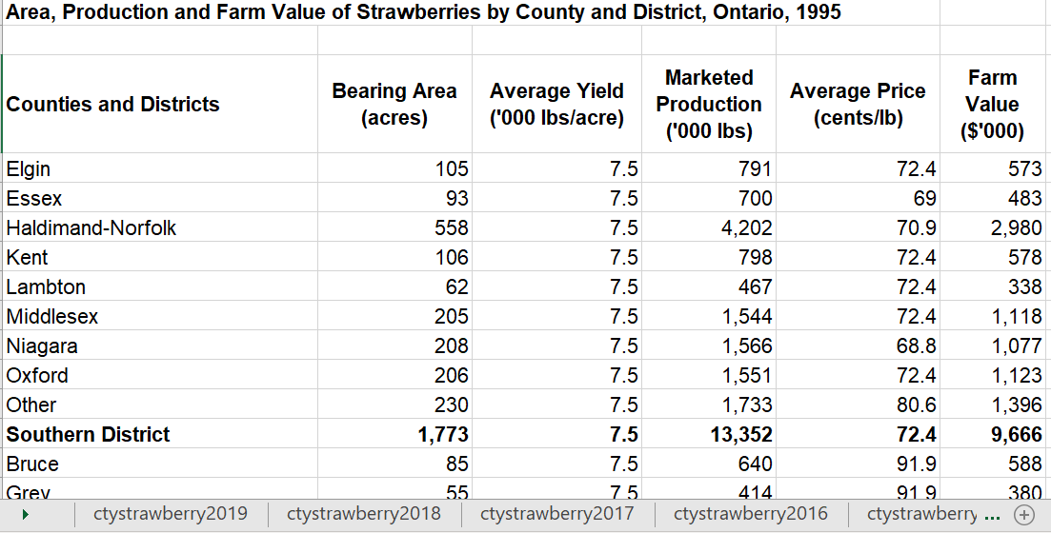
Data Set - Strawberry
Data set contains data for different years
The format remains the same across all the years for strawberry

Slide 8
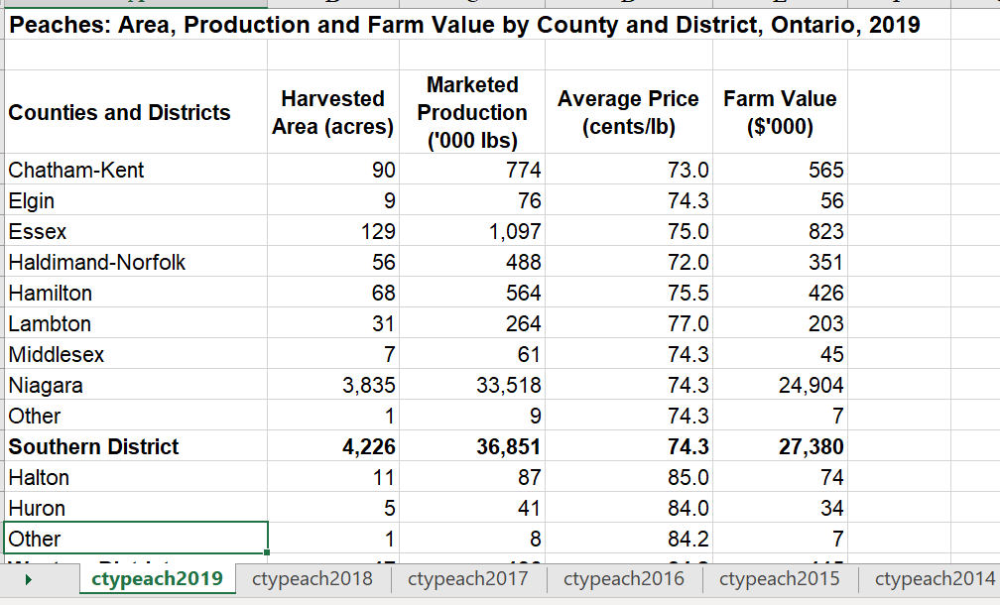
Data Set - Peaches
Data set contains data for different years
The format remains the same across all the years for strawberry

Slide 9
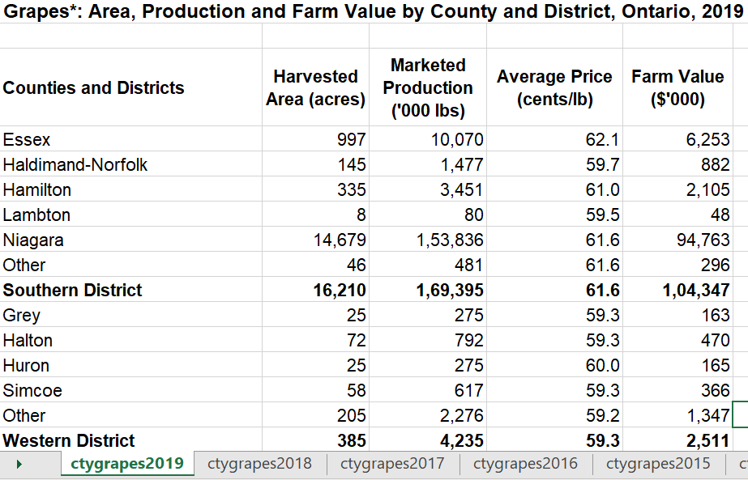
Data Set - Grapes
Data set contains data for different years
The format remains the same across all the years for grapes

Slide 10
EDA Process

Slide 11
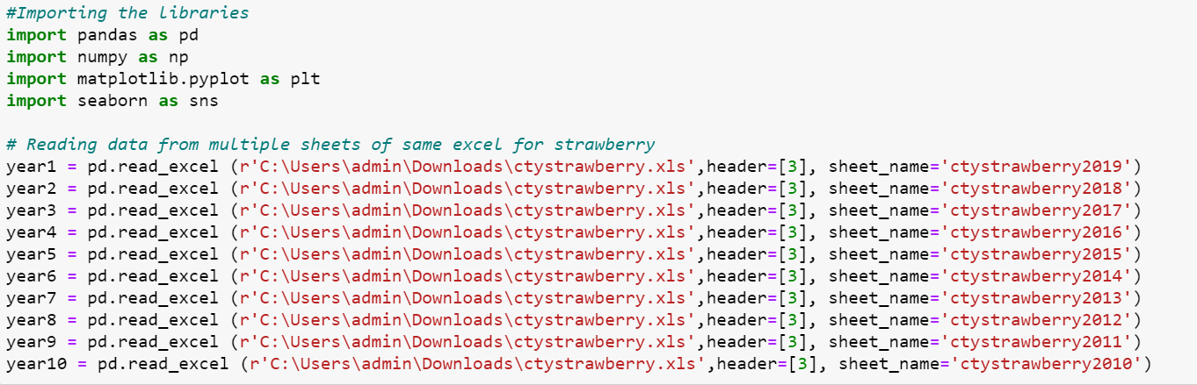
EDA Process- Single Sheet Reading
Using the extracted the data from required sheets.Though there was data for multiple years choose data from 2010 to 2019.
Header function defines from where you need to start reading the data from.

Slide 12
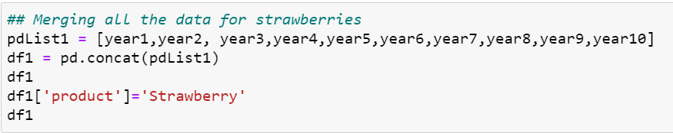
EDA Process- Concat
After data manipulation of each data set all the data related to strawberries is combined using the concat function.

Slide 13
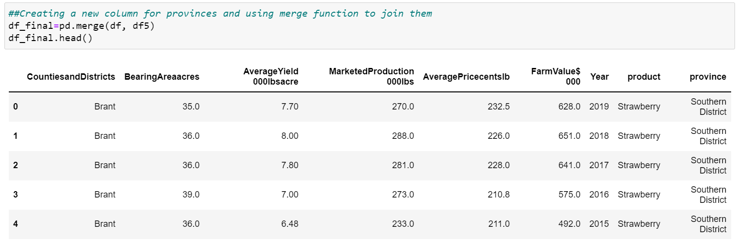
EDA Process- Merge
Created a list (df5) which defines which province contains which countries and districts.
Based on the list created a merge between the dataset (df) and list was done to add the province to the dataset.

Slide 14
EDA Process - Summarization
The following functions were used as part of the EDA process
Reading a specific sheet from a dataset of multiple sheets
Adding reference columns of year and the product for identification
String Replace
Concat
Columns Rename
Is null and duplicate checking
Extracting only not null values
Fill
Merge

Slide 15
Processed Dataset

Slide 16
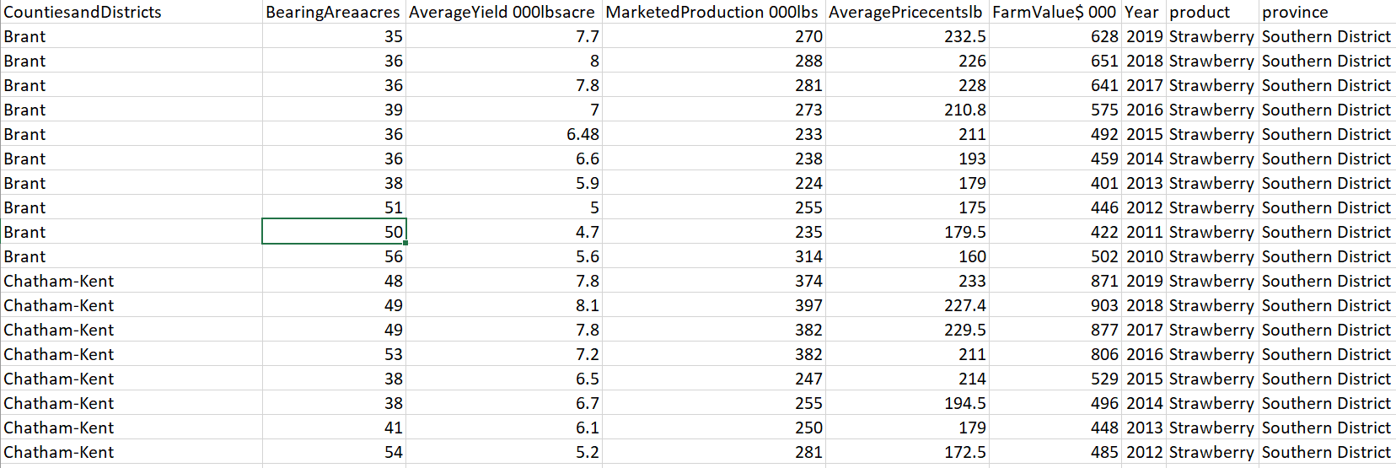
Final Dataset
Basis the data cleaning and data manipulation that was done on the original dataset the final data set has been created.
2 additional columns of have been added
Product denoting if its strawbeery,grapes or peached
Province denoting if its southern,western,northern etc

Slide 17
Power BI

Slide 18
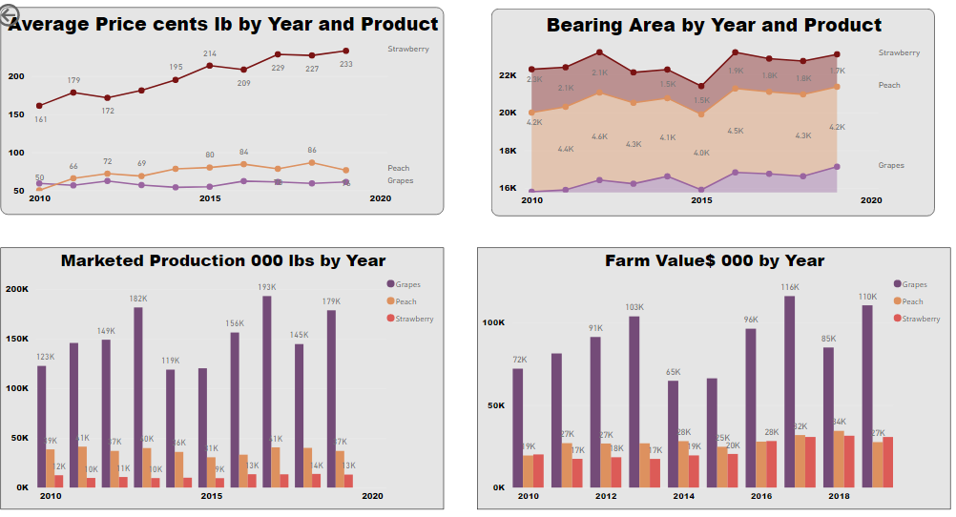
Dashboard 1 – Breakup Based on Year & Product
Dashboard provides a 1 shot view of how each of the product is behaving over the years in terms of price , bearing area required , marketed production and farm value.
Strawberry has the highest price and its on an increasing trend year on year.
In case of bearing area strawberries is more but the area of peaches is almost twice the size of grapes.
Similarly in terms of marketed production and farm value strawberry is less as compared to other 2 products

Slide 19
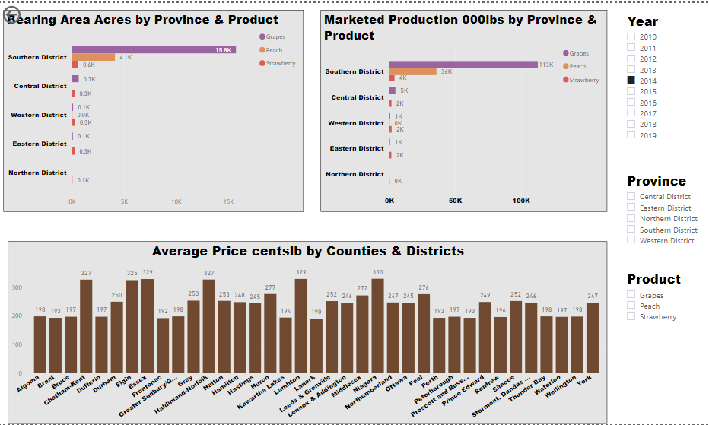
Dashboard – Breakup Basis Province & Districts
Dashboard can be filtered based on year, province and product.
Based on the selection the data will be change dynamically
In the given snapshot the charts show breakup for the year 2014 across different provinces and countries and districts

Slide 20
Conclusion

Slide 21
Conclusion
Strawberry has the best average price over the years and it follows an increasing trend.
Marketed production of grapes is the highest over the years whereas it requires the least amount of bearing land. At the same time it yields the least amount of price at a higher much farm value.
Peaches occupies almost double the bearing land as compared to grapes and strawberries with the pricing being slightly better than grapes.
Marketed Production of peaches and strawberries is almost constant over the last decade whereas that of grapes is fluctuating. Similar pattern is observed in farm size value

Slide 22
Conclusion
Southern province has the highest bearing and marketed production among all the provinces.
The average prices for strawberries is the highest in the southern province and is consistent throughout all the counties and districts.
Though the southern province has the highest bearing and marketed production among all the provinces.
The average prices for grapes is the highest in the southern province and is consistent throughout all the counties and districts.
Though the southern province has the highest bearing and marketed production among all the provinces for peaches.
The average prices for peaches is the highest in the southern province and is consistent throughout all the counties and districts except Hamilton.

Slide 23
References

Slide 24
References
Data Ontario
https://data.ontario.ca/dataset/ontario-fruit-and-vegetable-production
You tube link
https://www.youtube.com/watch?v=PHgfo0VVscM

Slide 25
Thank you

